Slide 1

STUDY MATE
BY TECHWIZ

Slide 2
Team Details
Members:
Meghana Mangipudi
K Apoorva
B Srujana Eleena
College: Stanley College of Engineering and Technology for Women
Year: III
Branch: CSE

Slide 3
Project Details
In today’s world of Covid-19, remote education is a necessity and our solution tries to improve the current system. We propose an interactive chatbot which can be used by students to know when homework in a particular subject is due. It can be used to keep track of the online classes scheduled by the teachers.
A student could ask their teacher these questions, but a chatbot implementation just makes the entire process much more interactive and accessible 24/7. We have also integrated our chatbot with Slack, which is a common software used to create workspaces for interaction regarding a variety of issues. A teacher can create a workspace with all the students and all the students can access this chatbot which has been integrated with this particular workspace.

Slide 4
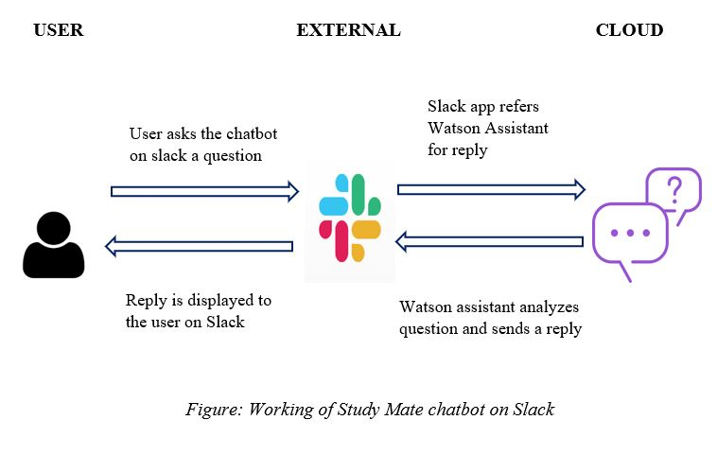
Architecture Diagram

Slide 5
Future Scope
This chatbot can show the student the timetable and lists the homework given per subject per day. These are currently the only two features of our chatbot but we plan to expand it over many more classes and connect our chatbot to a proper dynamic database in which teachers can update homework everyday and those changes can be reflected back in the chatbot. The chatbot can also help clear doubts or queries in the future. These are all the functionalities we plan to implement in our solution in the near future.

Slide 6
THANK YOU

